Slide 1
CUSTOMER PRODUCT RECOMMENDATION SYSTEM

Slide 2
SECTIONS
INTRODUCTION
DATASET OVERVIEW
EXPLORE DATA
DATA PREPROCESSING
FEATURE ENGINEERING
CORRELATION ANALYSIS
DIMENSIONALITY REDUCTION
MODELING
MODEL EVALUATION & ANALYSIS
RECOMMENDATION SYSTEM

Slide 3
Introduction
INTRODUCTION
DATASET OVERVIEW
EXPLORE DATA
DATA PREPROCESSING
FEATURE ENGINEERING
CORRELATION ANALYSIS
DIMENSIONALITY REDUCTION
MODELING
MODEL EVALUATION & ANALYSIS
RECOMMENDATION SYSTEM
Problem Statement
Objectives

Slide 4
Problem statement
Problem : Improve product recommendations from each group customer behaviors.
Goal :
creating new features
build a clustering model

Slide 5
Objectives
The objectives of the project are as follows
Data Cleaning & Transformation
Feature Engineering
Data Preprocessing
Customer Segmentation using K-Means Clustering
Cluster Analysis & Evaluation
Recommendation System

Slide 6
DATASET OVERVIEW
INTRODUCTION
DATASET OVERVIEW
EXPLORE DATA
DATA PREPROCESSING
FEATURE ENGINEERING
CORRELATION ANALYSIS
DIMENSIONALITY REDUCTION
MODELING
MODEL EVALUATION & ANALYSIS
RECOMMENDATION SYSTEM

Slide 7
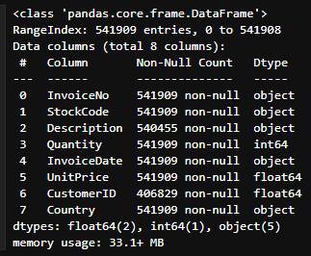
Dataset source : https://archive.ics.uci.edu/dataset/352/online+retail
Dataset size : 541,909 rows and 8 columns
Features of Dataset :
InvoiceNo : invoice number for each transaction
StockCode : the product code for each item
Description : descriptions of the products
Quantity : quantity of products purchased in each transaction
InvoiceDate : records the date and time of each transaction
UnitPrice : price of each product
CustomerID : customer's ID
Country : country where each transaction occurs

Slide 8
EXPLORE data
INTRODUCTION
DATASET OVERVIEW
EXPLORE DATA
DATA PREPROCESSING
FEATURE ENGINEERING
CORRELATION ANALYSIS
DIMENSIONALITY REDUCTION
MODELING
MODEL EVALUATION & ANALYSIS
RECOMMENDATION SYSTEM

Slide 9
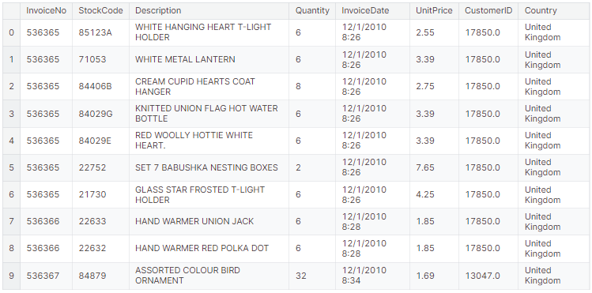
First 10 rows of dataframe

Slide 10
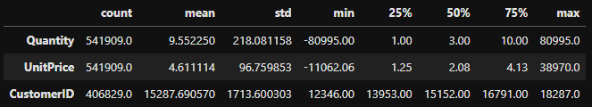
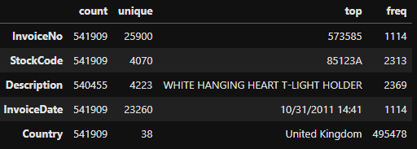
SUMMARY STATISTICS
Numerical variable
Categorical variable

Slide 11
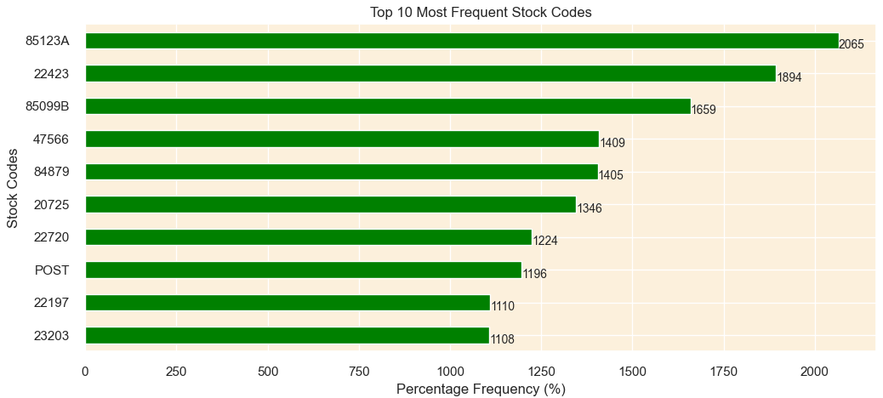
TOP 10 MOST FREQUENT STOCK CODES

Slide 12
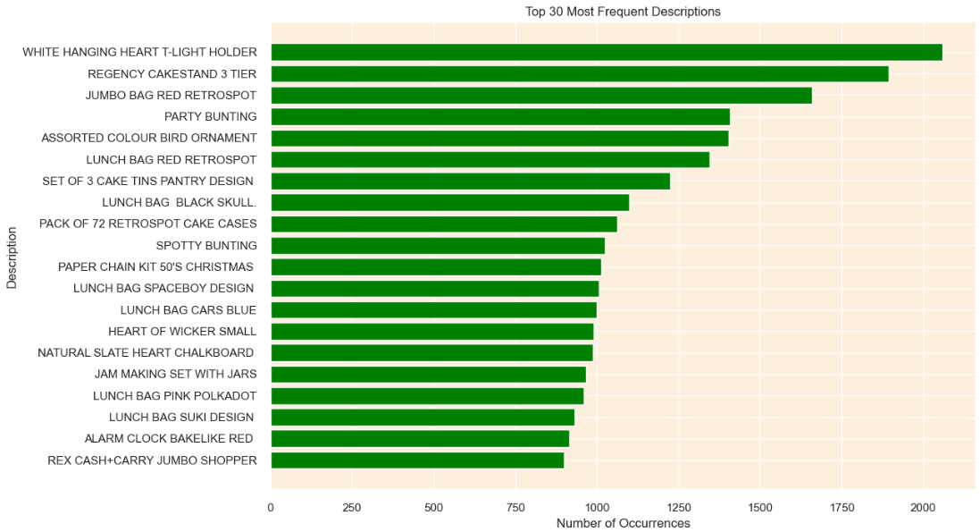
TOP 30 MOST FREQUENT descriptions

Slide 13
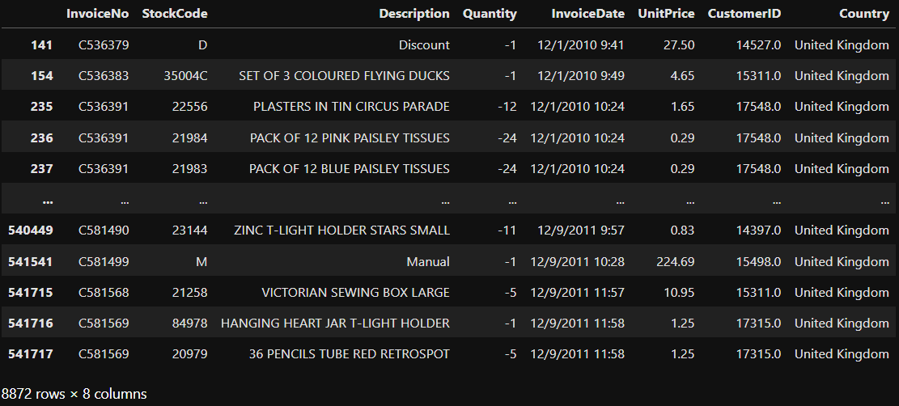
Show all canceled transaction
From below dataframe, there are total 8,872 transaction are cancelled
these transactions by filtering the rows where the InvoiceNo starts with "C".

Slide 14
DATA PREPROCESSING
INTRODUCTION
DATASET OVERVIEW
EXPLORE DATA
DATA PREPROCESSING
FEATURE ENGINEERING
CORRELATION ANALYSIS
DIMENSIONALITY REDUCTION
MODELING
MODEL EVALUATION & ANALYSIS
RECOMMENDATION SYSTEM
4.1 Handling Missing Values
4.2 Handling Duplicate Values
4.3 Handling Cancelled Transactions
4.4 Correct StockCode Anomalies
4.5 Cleaning Description
4.6 Treating Zero Unit Prices

Slide 15
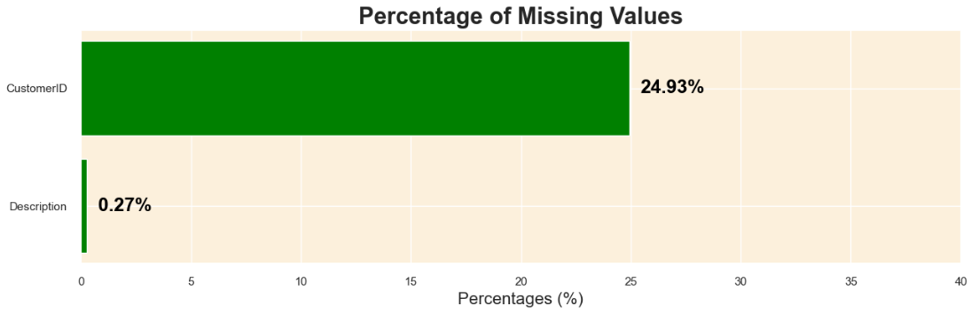
4.1 HANDLING MISSING VALUES

Slide 16


HANDLING missing value strategy
CustomerID (24.93% missing values)
- The CustomerID column contains nearly a quarter of missing data. This column is essential for clustering customers and creating a recommendation system. Imputing such a large percentage of missing values might introduce significant bias or noise into the analysis.
Description (0.27% missing values)
- The Description column has a minor percentage of missing values. However, it has been noticed that there are inconsistencies in the data where the same StockCode does not always have the same Description. This indicates data quality issues and potential errors in the product descriptions.
By removing rows with missing values in the CustomerID and Description columns, we aim to construct a cleaner and more reliable dataset, which is essential for achieving accurate clustering and creating an effective recommendation system.

Slide 17
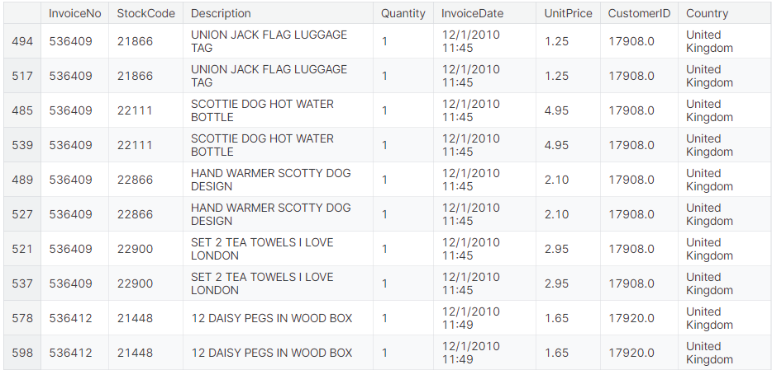
4.2 HANDLING DUPLICATE VALUES

Slide 18
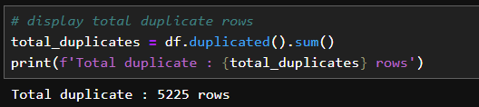
HANDLING DUPLICATES strategy
There are 5225 dulplicates rows, the presence of completely identical rows, including identical transaction times, suggests that these might be data recording errors rather than genuine repeated transactions.
Keeping these duplicate rows can introduce noise and potential inaccuracies in the clustering and recommendation system.
Removing these rows will help in achieving a cleaner dataset, which in turn would aid in building more accurate customer clusters based on their unique purchasing behaviors.

Slide 19
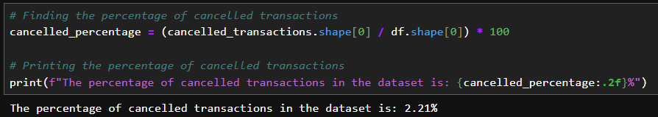
4.3 HANDLING cancelled transaction
We know that there are total 8,872 cancelled transactions from data exploration
The percentage of total transactions in the dataset 2.21 %
Strategy for handling cancelled transactions
The project's objective to cluster customers based on their purchasing behavior and create a recommendation system.
Therefore, the strategy is to retain these cancelled transactions in the dataset, marking them distinctly to do further analysis.

Slide 20
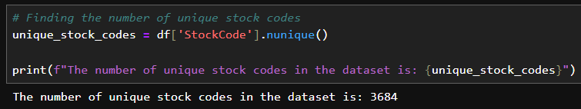
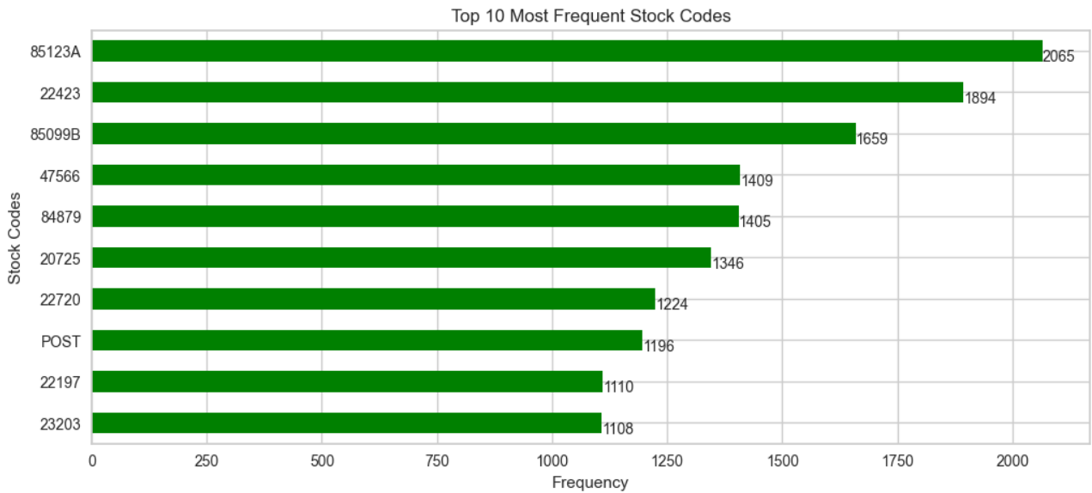
4.4 HANDLING STOCKCODE ANOMALIES
There are 3,684 unique stock codes
Top 10 most frequent stock codes

Slide 21
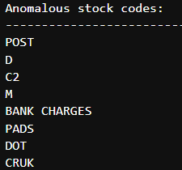
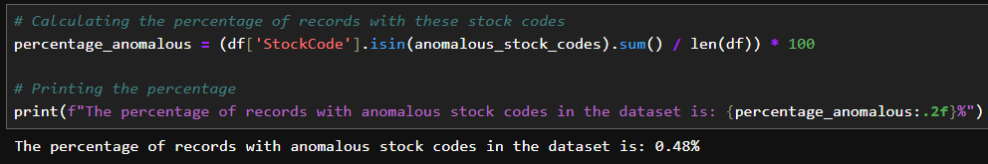
All types of anomalous stock codes
There are 0.48 % of anomalous stock codes in the datasets
Strategy for handling stock code anomalies
From the previous visualization, we observed that those anomalious stockcodes did not
represent actual products and contains very small amount in the dataset.
including them in the analysis might create a noise and affect to the clustering and
recommendation system.
Hence, we will remove the row that included has stock anomalies.

Slide 22
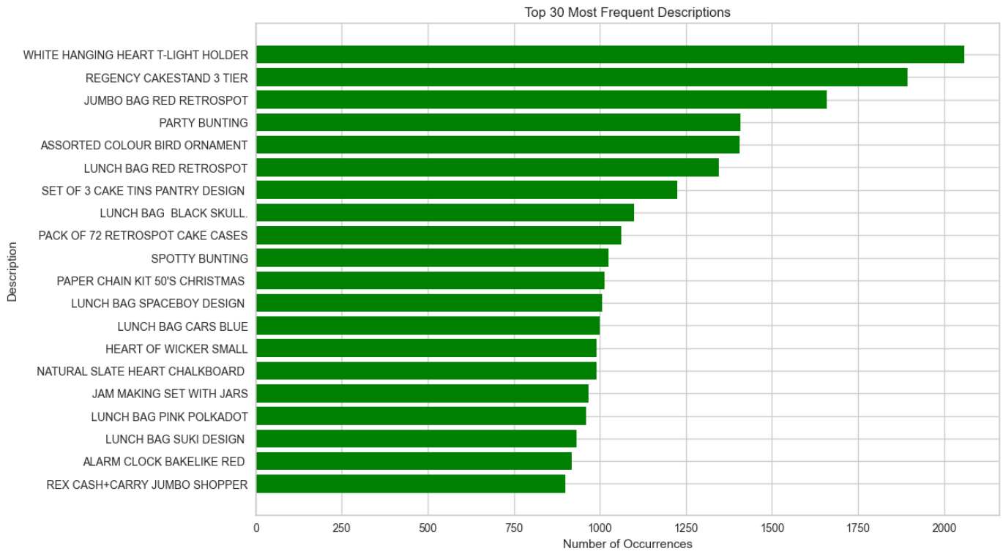
4.5 CLEANING DESCRIPTION COLUMN
Top 30 most frequent unique description in dataset.

Slide 23
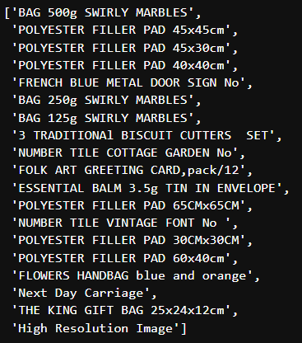
Descriptions containing lowercase characters
The descriptions that contain lowercase characters, it shows some non-product description,
such as "Next Day Carriage" and "High Resolution Image". Those seem to be unrelated to the
actual products

Slide 24
CLEANING DESCRIPTION strategy
Step 1 : Remove the rows where the descriptions contain non-product like "Next Day Carriage" and "High Resolution Image“.
Step 2 : For the remaining descriptions with mixed case, change to all uppercase. This will also assist in reducing the chances of having duplicate entries with different case styles.

Slide 25
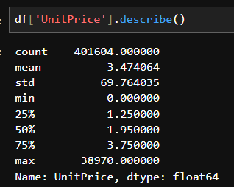
4.6 treating zero unit prices
Statistical “UnitPrice” column
The minimum unit price is zero. The transaction that contain zero price indicating a free item or a data entry error.
Including these transactions in the clustering analysis might introduce noise and cause distortion of distance which leading to incorrect cluster assignments.

Slide 26

Handling zero unit prices strategy
Remove the transactions that has the price that less than or equal to zero from the dataset
Which is essential for building an accurate and reliable clustering model and recommendation system.

